Slide 1
Reinforcement Learning
Agents, Environment, Rewards, Exploration
Introduction to Deep Learning: Class 7.2

Slide 2
Module outline
Class | Title | Main output
1 | Bandits, MDPs, Returns | agent/environment/reward
2 | Value Functions and Bellman Equations | Learning to solve a reinforcement learning problems by iteratively estimating the value of a state
3 | Monte Carlo, TD, SARSA, Q-Learning | On-policy vs off-policy, sampled experience
4 | Policy Gradients and REINFORCE | log-prob weighted by reward
5 | Actor-Critic and PPO | advantage, critic, clipping
6 | RLHF and GRPO | PPO/GRPO to LLM training

Slide 3
Agenda and references
Agenda:
state-value function V
action-value function Q
Bellman expectation equation
Bellman optimality equation
policy evaluation
value iteration
References:
https://spinningup.openai.com/en/latest/spinningup/rl_intro.html
David Silver lectures:
Lectures 2 and 3

Slide 4
Agent-Environment loop
state: what the agent sees
action: what the agent does
reward: scalar feedback
next state: what happens after the action

Slide 5
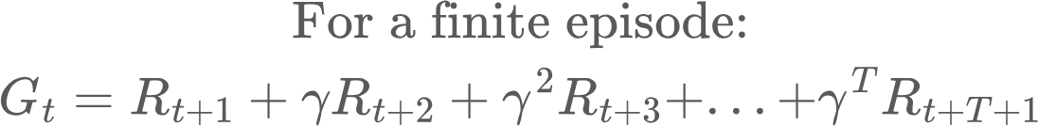
Episodes and Trajectories
Episode: Full (State, Action) sequence until some end state (eg., game over)
We start in a state, take an action, get a reward and go to the next state..
Return vs Reward. You get a reward potentially after every action. Return is the total (potentially discounted) reward for an episode. Goal is to maximise reward
We start in a state, take an action, get a reward and go to the next state..
Return vs Reward. You get a reward potentially after every action. Return is the total (potentially discounted) reward for an episode. Goal is to maximise reward

Slide 6
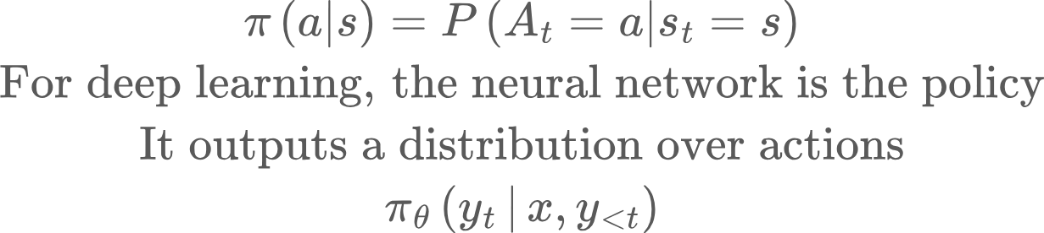
Policy
A policy defines a probability distribution over actions at a state

Slide 7
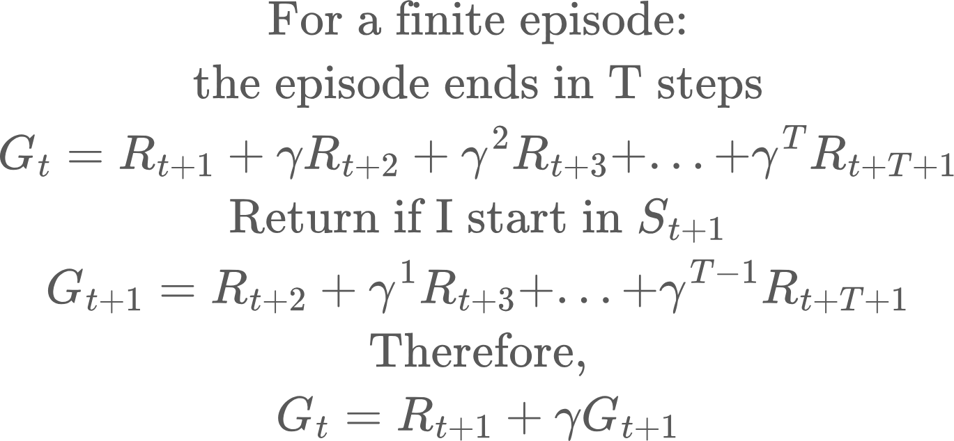
Discounted returns: Recursion
Return from now = reward from next step + discounted return from the next state onward.

Slide 8
Value function
Expected reward, if we start from state S, then follow the policy
Value function depends on the policy
Example:
B _ _ _ _ E
Reward: 1 for reaching E, 0 everywhere else, a penalty of -0.1 for taking a step
Policy 1: Always move right. V1 = 0.5 0.6 0.7 0.8 0.9 0 <- convention. Reward at the terminal state = 0, as episode terminates
Policy 2: Take a random step. V2: much lower, as it will take more steps to reach E
So, V1 > V2. What if we didn’t have the step penalty?

Slide 9
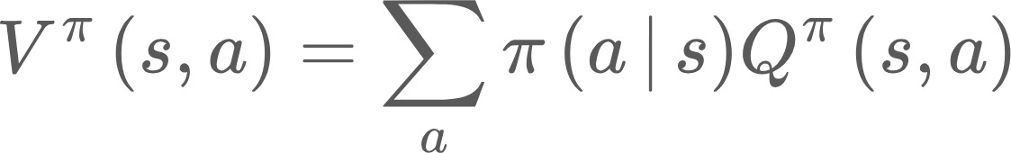
Q function
Q function is a function of state and action.
Q(s,a): The value of taking action a in state s, then follow policy afterwards
V(s) | How good a state is under a policy
Q(s,a) | How good is an action a in state s, and then follow the policy

Slide 10
Advantage function
Reinforcement learning on LLMs uses advantages. We’ll come back to it later

Slide 11
Estimating the value function: Bellman recursion
State transition dynamics
Discounted value of the new state
Policy
Reward of taking action a
Value at state s
Sum over actions
Sum over next states

Slide 12
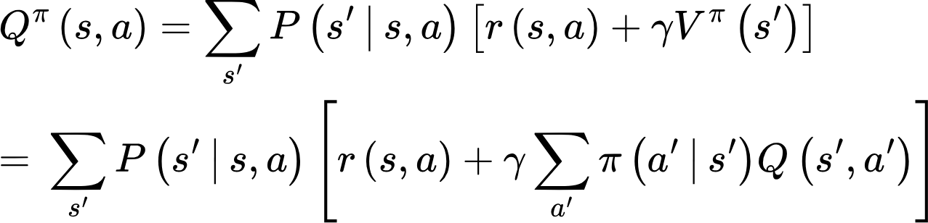
Bellman equation for Q
policy
Q of future actions from next state
Sum over next states

Slide 13
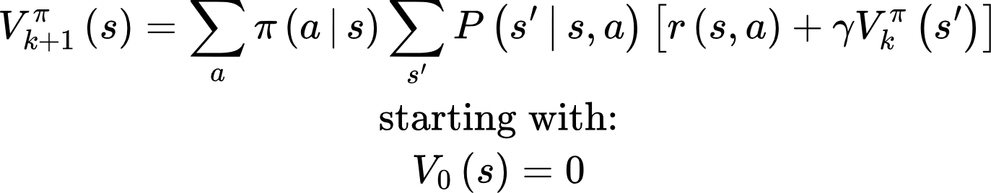
Iterative value estimation
Given a policy, estimate the value of each state
Technique: apply bellman recursion repeatedly, until the values settled down.
At first, all values are zero.
Then states near terminal rewards get meaningful values.
Then states one step farther away get meaningful values.
Then states even farther away get meaningful values.
value_iteration.py

Slide 14
Iterative value estimation
Grid world:
S - - +1
- X - -1
- - - L
-0.236 -0.071 0.132 0.000
-0.371 WALL -0.509 0.000
-0.479 -0.567 -0.638 -0.822

Slide 15
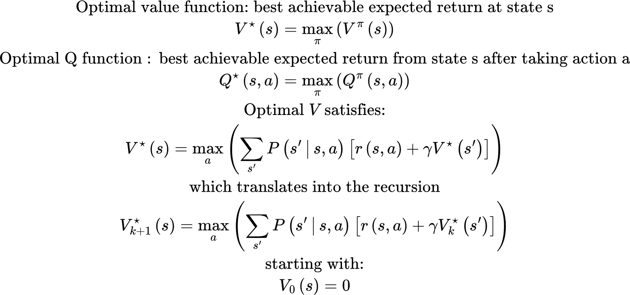
Optimal policy estimation
Given an environment, how do we determine the value function of the optimal policy?
No more averaging actions from a policy. Pick the best action using current estimate of V. Ultimately V will settle into the Value function for the optimal policy

Slide 16
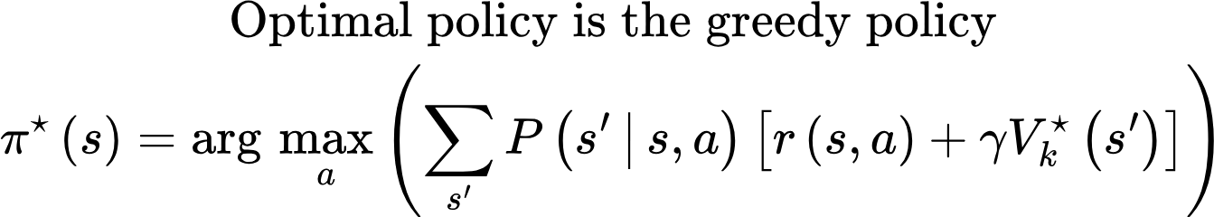
Optimal policy estimation
What is the optimal policy?

Slide 17
Optimal policy estimation: Simulation
Optimal values:
0.960 0.980 1.000 0.000
0.941 WALL 0.980 0.000
0.921 0.941 0.960 0.941
Greedy policy:
R R R T
U X U T
U R U L
optimal_policy_iteration.py

Slide 18
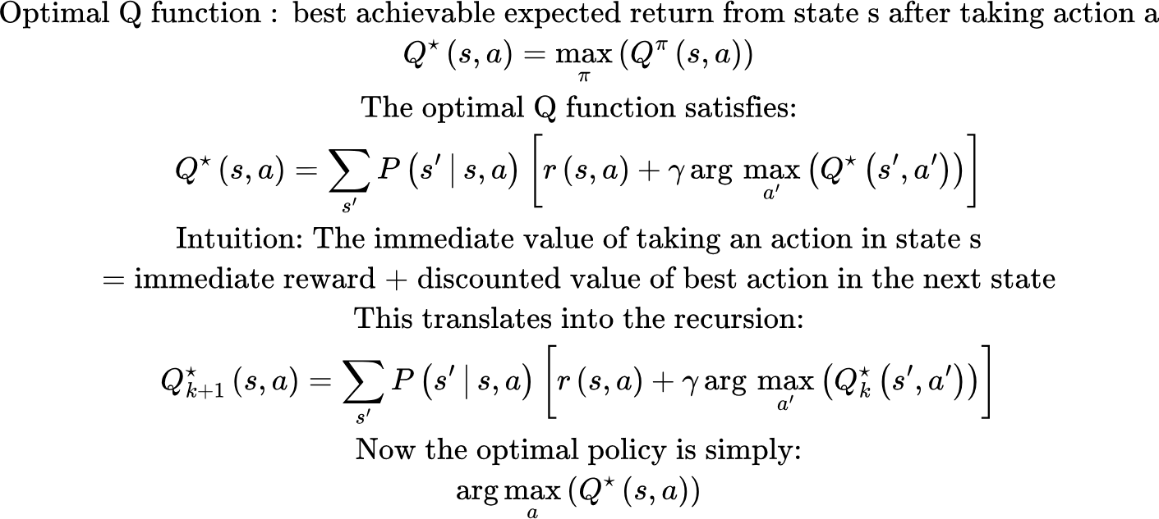
Optimal policy estimation using Q function
We estimate the Value function of the optimal policy, which then gives us the optimal policy. We can do the same using the Q function

Slide 19
Coding problems
Estimate value function for different values of gamma (0.5, 0.9). How does the value function change? Does the optimal policy change?
Change the reward at (1,3) = -0.5, and step_reward = -0.5. Does the optimal policy change? Why?
Add stochastic transition: Modify value iteration so that intended actions succeed with probability 0.8 and slip sideways with probability 0.1 each (see optimal_policy_iteration_stochastic.py)

